Slide 1
Cloud Based Python Code Compiling Environment
CSE540 Cloud Computing
Group - 1 Cloud smith

Slide 2
Team Members
Enrollment Number | Name
AU2140141 | Krutarth Trivedi
AU2140154 | Harsh Loriya
AU2140170 | Krishna Patel
AU2140187 | Priyam Shah

Slide 3
Problem Statement
Designed and implemented a cloud-based system for compiling and executing Python code, optimized for machine learning (ML) tasks.
To design a robust, scalable, and secure online compiler that allows users to compile seamlessly.

Slide 4
Components Overview
Kernel-Virtual Machine(KVM):
Hypervisor which provides isolated environments for running vm securely.
Worker Nodes:
These are distributed nodes responsible for actual data processing
Server nodes:
Balances load between worker nodes and schedules jobs efficiently.
Docker:
Isolated environments within each VM where user code is executed independently.

Slide 5
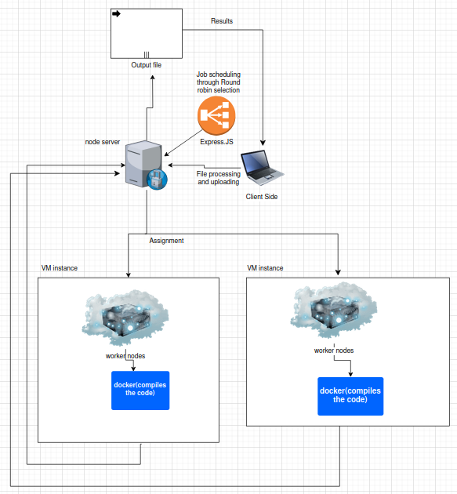
Cloud Architecture

Slide 6


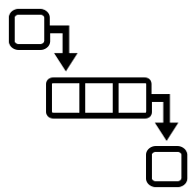
Server Handling
File Storage: The uploaded files are stored temporarily in the server to ensure quick processing access
Job Creation: After the file upload a job object is created that includes user details and file path for easy tracking
Job Queueing: The newly created job is added to a queue for systematically processed using round robin algorithm

Slide 7
Worker Node Processing
Workers Node role:
A worker node is responsible for creating a docker container and executing necessary computations.
After processing the requested file, it sends output.txt file to server.

Slide 8
Hardware and Software platform used
PC (CPU and Memory)
KVM
Docker
Express.JS
Ubuntu Server and GUI
Multer
Axios

Slide 9
Cloud services
We have design and implemented Platform as a service for compiling and reverting back the output file of python code.

Slide 10
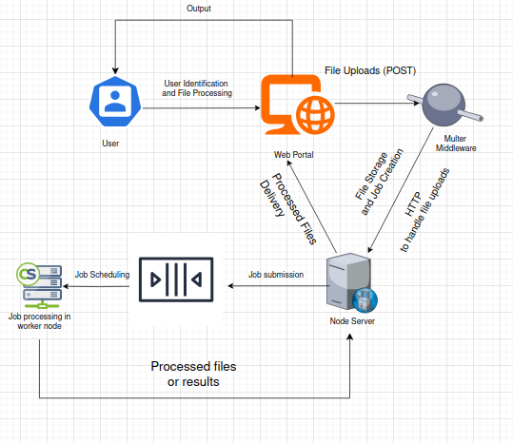
Logical design

Slide 11
Code snippets
All the codes, shell scripts and installation guides are available on github page.
https://github.com/krishna-2009/Cloud-Computing-CSE540-Project

Slide 12
Other Attempted Approaches.
FastAPI
Xen
FTP Protocol
Connecting multiple cpu to increase resources
NGINX Load Balancing
SOCKET scripting.
File restrictions for isolation
etc.

Slide 13
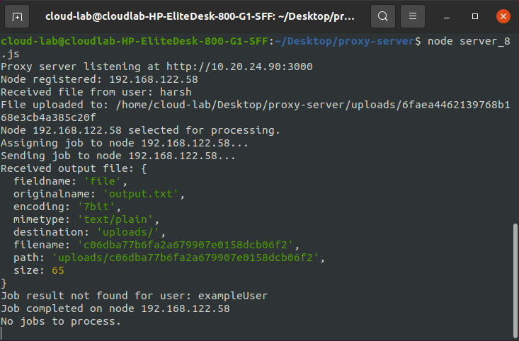
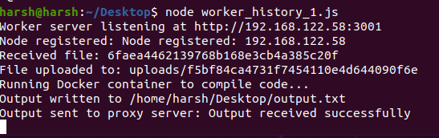
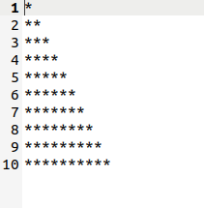
Results

Slide 14
Future Enhancements
Dynamic Load Balancing
Security Enhancements
User Interface
Efficient VM auto-scaling

Slide 15
References
https://ubuntu.com/server/docs/virtual-machine-manager
https://www.geeksforgeeks.org/how-to-build-a-simple-web-server-with-node-js/
https://docs.docker.com/manuals/
https://developer.mozilla.org/en-US/docs/Web/HTTP/Proxy_servers_and_tunneling
https://devdocs.io/express/
https://ubuntu.com/blog/kvm-hyphervisor

Slide 16
Thank You.

